Slide 1
Building and Teaching a Complete Serverless Solution
Donald F. Ferguson
Professor of Professional Practice, Dept. of Computer Science, Columbia University
CTO and Co-Founder, Seeka TV (dff@cs.columbia.edu, donald.ferguson@seeka.tv, dff9@columbia.edu)
Third International Workshop On Serverless Computing (WoSC) 2018, San Francisco, CA. 02-Jul-2018
(https://www.serverlesscomputing.org/wosc3/)

Slide 2
The Solution
Two elements to the company
Multi-tenant platform for managing and enabling access to content.
A “channel” focused on enabling independent series producers to build and audience.
End-Users
Browse and search.
Access (watch content)
Interact
Comment.
Simultaneous viewing and chat.
Social media integration.
Rate.
Pay/Tip
Providers
Manage content and metadata.
Control access.
Pay-Wall integration.
Schedule and control placement.
Private channel.
Web sites.
Social media.
Statistics and analysis.

Slide 3
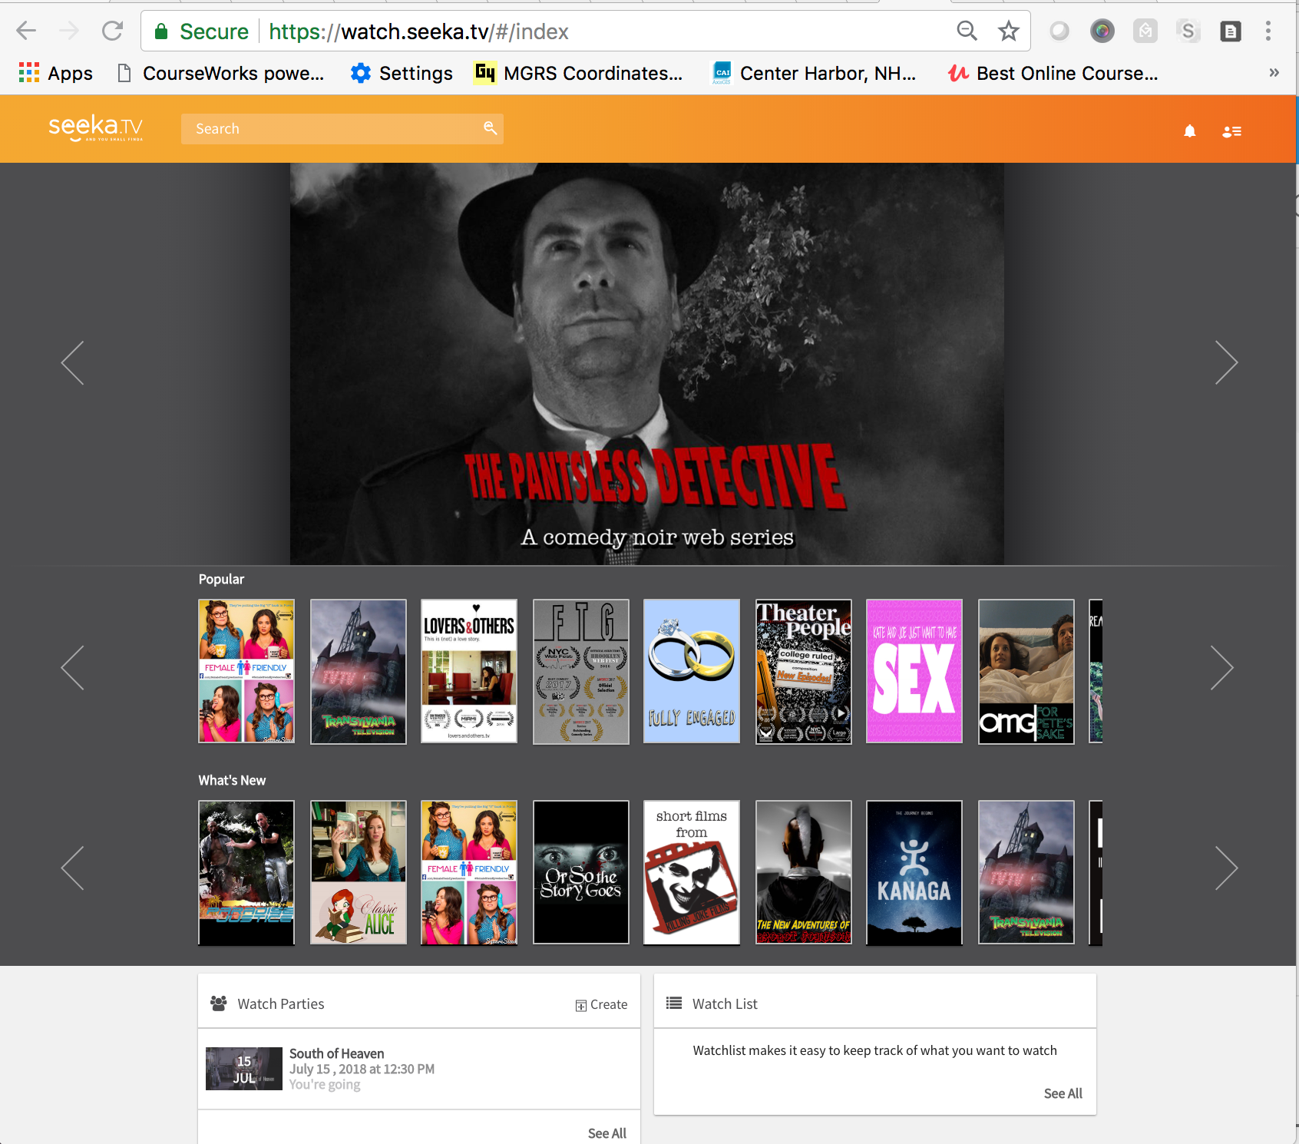
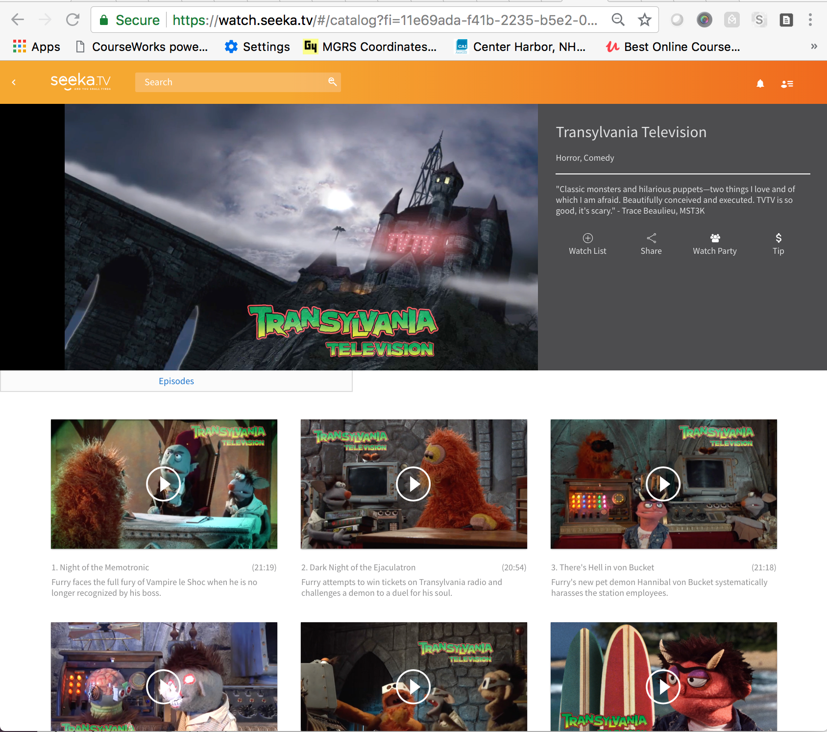
The Solution

Slide 4
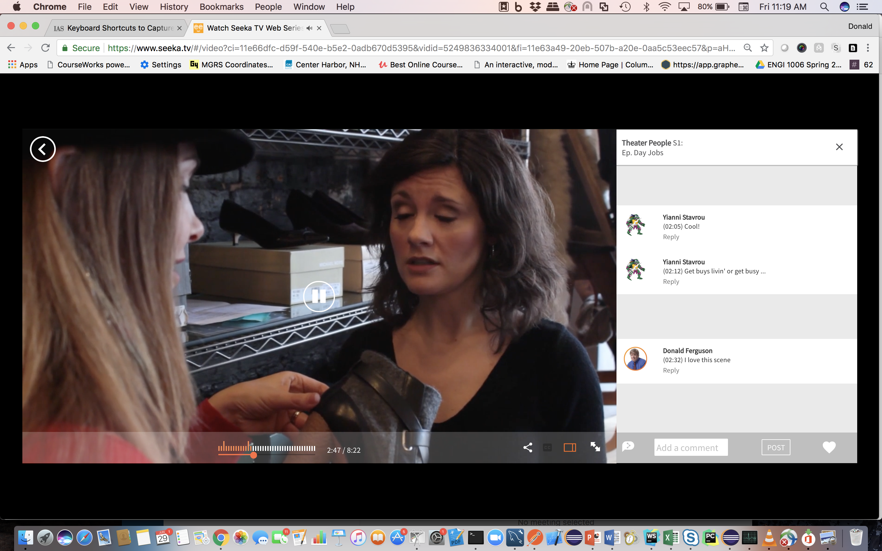
The Solution

Slide 5
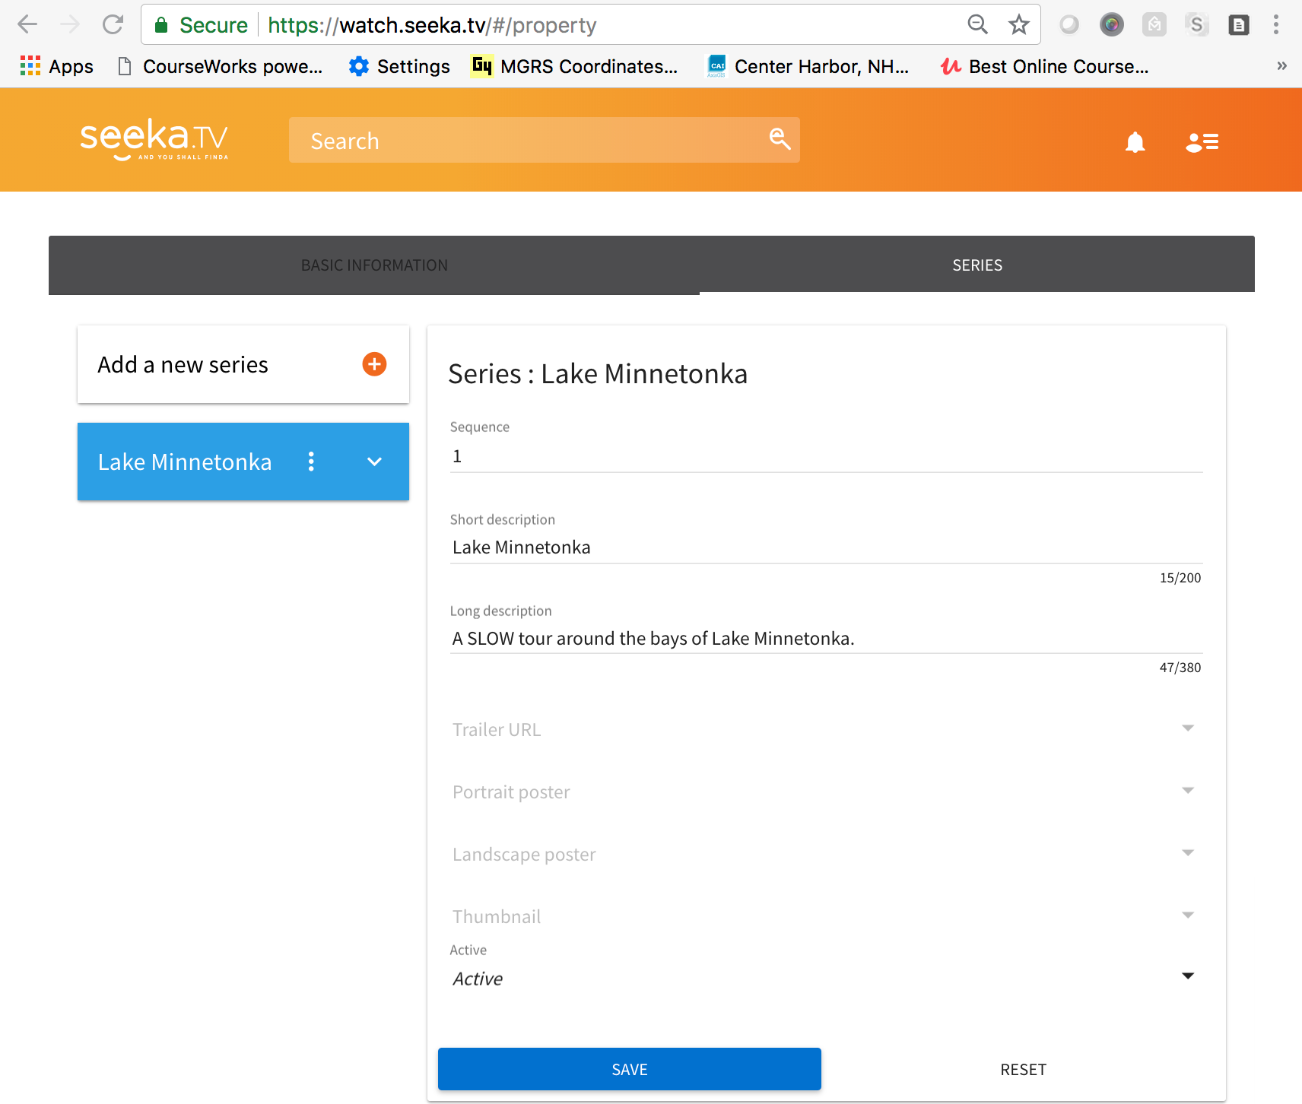
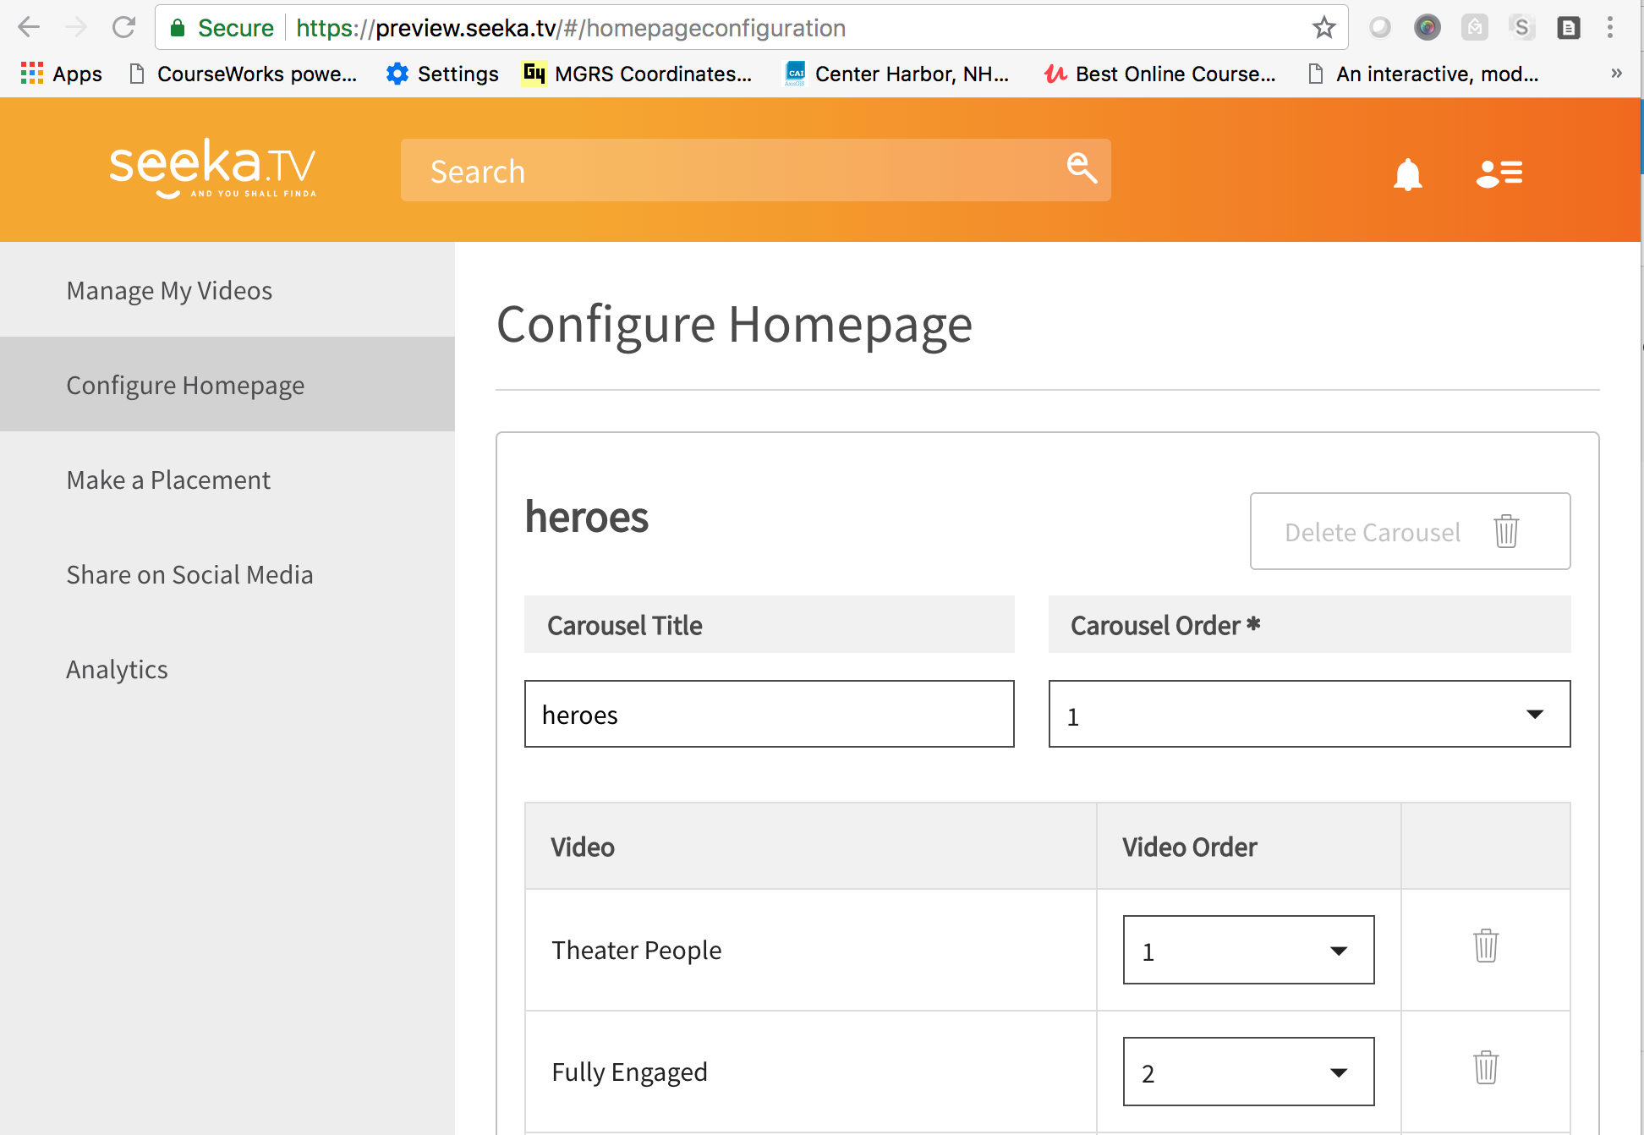
The Solution

Slide 6
Implementation Architecture
AWS Application

Slide 7
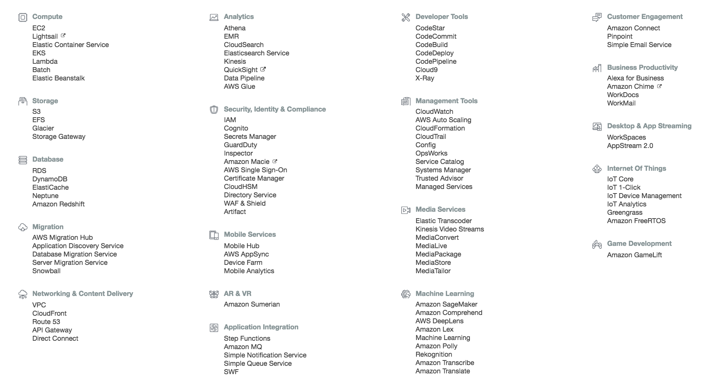
AWS Services

Slide 8
AWS Services
Comments:
I probably forgot a couple.
There is a bunch we should/will use:
Cognito, SSO
CloudSearch, QuickSight, …
Media services
AI (e.g. for recommendation)
And a lot of the 3rd parties we use are themeselves built on top of AWS.

Slide 9
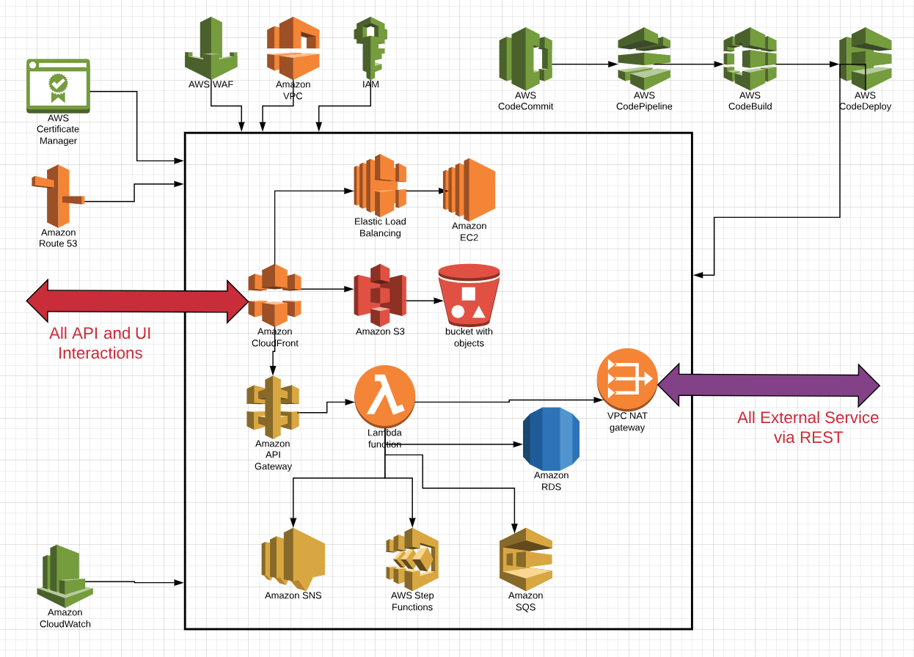
An Attempt to Draw an Architecture Diagram
Some numbers:
2 EC2 instances.
21 RDS instances.
152 Lambda Functions.
82 S3 buckets.
1 Neo4J DB.
17 CloudFront Distributions
52 API GW APIs.

Slide 10

When you do know know what to do, do what you now how to do.
Integration Composition Services
User Info
Module
Module
“Browser”
Content Management
Module
Routing Module
Module
Social Media
Module
Module
… … … …
Lambda Function == Container
Microservice == Module
Module

Slide 11
It Worked, but …

Slide 12
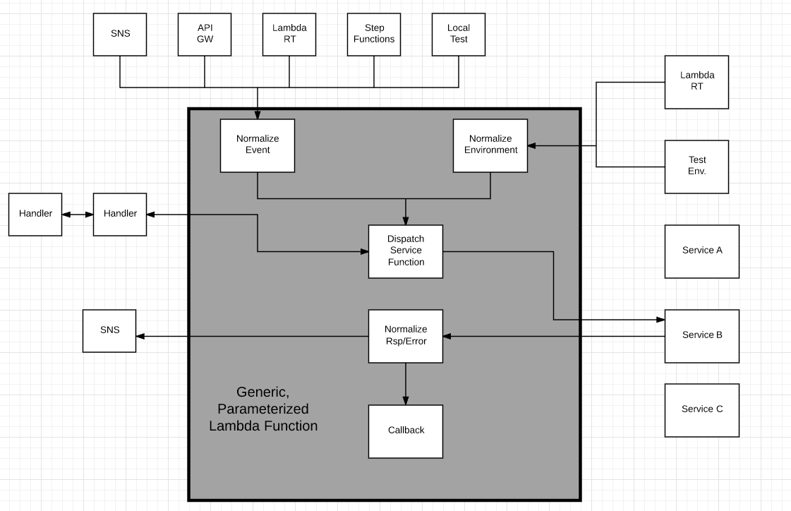
Current Approach
Write code as functions: msg = f(msg)
Micro-service is
A set of functions.
A single repo.
Individual IDE project.
Completely testable on desktop.
Wrapped with generic lambda function code and event normalization.
Deployed as Lambda function instance.
Configured to “events.”
Lib
Lib
Lib
Cloud Services
AWS APIs
Lib
Lib
Lib
Lib

Slide 13
Some Perspective

Slide 14
“Serverless Computing (Serverless) is emerging as a new and compelling paradigm for the deployment of cloud applications, and is enabled by the recent shift of enterprise application architectures to containers and micro services.”
“Enabled by …” Yes.
Increased focus on event-based programming.
Small(er), focused pieces of code.
Polyglot programming and persistence.
Loose coupling and independent change.
I have come to think of severless being like an old-style pub/sub topic space or programmable wiki/web.
The application is a URI space.
Events happen on URLs → map to a function.
You may choose to have a URL subtree map to a microservice.
The runtime is the OS process model.

Slide 15
“Serverless architectures offer different tradeoffs in terms of control, cost, and flexibility. For example, this requires developers to more carefully consider the resources used by their code (time to execute, memory used, etc.) when modularizing their applications. This is in contrast to concerns around latency, scalability, and elasticity, which is where significant development effort has traditionally been spent when building cloud services.”
Scalability, elasticity, latency: Serverless
Does not change development wrt to scalability, elasticity, latency.
Vastly simplifies the environment definition, config, operation, etc.
“Consider resources … when modularizing application:”
Hmm. I almost never consider this. The function runs and isolation and the function consumes what the function needs.
API calls effect cost:
The multi-programming level is approximately 1, unlike an app sever.
You pay for execution duration when the thread is waiting.
You think of your application as a set of steps/commands.
Each step is one serverless function execution/invocation.
You should probably do this anyway for long-running, complex tasks.

Slide 16
“A rich ecosystem of services built into the platform is typically easier to compose and would offer better performance. However, composing external services may be unavoidable, and in such cases, many of the benefits of serverless disappear, including performance and availability guarantees.”
The cloud and its APIs are the platform.
Even in J2EE or .NET, you should assume that
The service API is “local.”
The service implementation is remote.
Ecosystem of services:
Technical services might be built into the platform/server.
Business services are almost always an API call.
Availability is an issue. A bigger issue is understanding what needs to be undone or redone.

Slide 17
Teaching this Stuff …
Taught serverless/aaS/Microservices 4 semesters to seniors, MS and Ph.D. students.
Students lack understanding of basic concepts in SW engineering, e.g.
Design patterns.
Pub/Sub, event-driven-architecture.
Queueing, orchestration, workflow.
Asynchrony
There is a huge startup overhead to get a basic “HelloWorld” to work.
Lambda.
API GW.
Correctly setting policies.
etc.

